Slide 1
Spectrometers for Continuum Emission around Al K-edge

Slide 2
What we once agreed on
KAP (flat) spectrometer with large spectral range -> for overview of source spectrum but not for transmission spectroscopy
APD (flat) spectrometer with two crystals
Mica (R=150mm) FSSR -> imaging spectrometer
Shielding
Magnet
Frontside emission since transmission through 1um Au, Sm and 10um Teflon is only a few %

Slide 3
ADP Spectrometer
Topview
ADP
View on Camera Chip
Backlighter
Camera Chip
E (source spec)
E (trans spec)
27.6mm
PHELIX
6.9mm
Sample
Ions
ADP

Slide 4
Topview
ADP
View on Camera Chip
TCC
Camera Chip
PHELIX
E (source spec)
E (trans spec)
27.6mm
6.9mm
Sample
Ions
ADP

Slide 5
ADP Spectrometer
(of course also a rotation of crystal and chip would be possible)
Sideview
Backlighter
PHELIX
Sample
ADP
(crystals behind each other in this view)
Camera Chip
The rotation in this view changes projected angles in topview in order to still fulfill Bragg condition
Also influences spectrometer length (which is calculated in spectrometer plane)

Slide 6
TCC
PHELIX
Sample
ADP
Camera Chip

Slide 7
Constraints ADP Spectrometer
Crystal length (should be ok, but check)
Resolution better than 0.5eV -> in particular source broadening
Spectral range at least 1550-1600eV (would be good to cover up to 1600 also for Al He alpha emission)
Distance backlighter to sample at least 3mm
sample at most 1mm

Slide 8
General thoughts concerning rotated camera (two crystal 2C) setup
Dependence of sample length on Bragg angles (and influence of source size on sample length) as in von-Hamos geometry
Formulas concerning geometry different because spectral range on chip differnt (furthermore not necessarily symmetric path lengths on both sides of the crystal)
Source broadening different -> source size 1:1 on chip

Slide 9




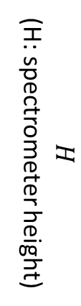

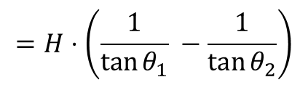
Calculation of Crystal Length
$$φ=θ_{2}−θ_{1}=\arcsin{\frac{n h c}{2d E_{2}}}−\arcsin{\frac{n h c}{2d E_{1}}}$$
$$φ$$
$$H$$
(H: spectrometer height)
$$=H⋅\left(\frac{1}{\tan{θ_{1}}} −\frac{1}{\tan{θ_{2}}}\right)$$
crystal length
$$E_{1}>E_{2}$$
$$θ_{2}$$
$$θ_{1}$$

Slide 10






Calculation of Sample Length
ions
$$dist$$
laser
$$θ_{1}$$
$$φ$$
sample length
$$θ_{2}$$
$$θ_{1}$$
$$=\left(\tan\left(θ_{1}+φ\right)−\tan\left(θ_{1}\right)\right)⋅dist$$

Slide 11
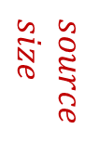








Influence of Source Size
ions
$$dist$$
laser
$$source \\ size$$
$$θ_{1}$$
$$φ$$
sample length
$$θ_{2}$$
$$θ_{1}$$
$Δ$ sample length = source size
$$=\left(\tan\left(θ_{1}+φ\right)−\tan\left(θ_{1}\right)\right)⋅dist$$
(also some $Δ$ crystal length)

Slide 12





Source Broadening
(drawing symmetric, but does not have to be)
laser
ions
$$source \\ size$$
$$φ$$
$$θ_{2}$$
$$θ_{1}$$
$$θ_{1}$$
source size direclty is spatial broadening on detector

Slide 13
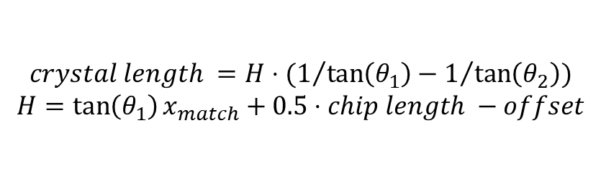



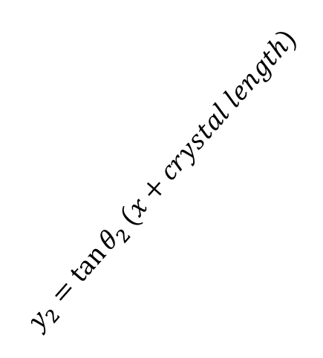

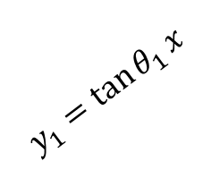

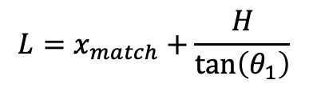
Calculating crystal length for rotated cam
$$90° \\ −θ_{2}$$
chip length
offset
dist_3
$$y_{2}=\tan{θ_{2}}(x+crystal length)$$
$$θ_{1}$$
$$H$$
$$y_{1}=\tan{θ_{1}}x$$
crystal length
dist_2
$$θ_{2}$$
$$θ_{1}$$
(0,0)
$$x_{match}: y_{2}\left(x_{match}\right)−y_{1}\left(x_{match}\right)=chip length \\ ⇒I. x_{match}\left(\tan\left(θ_{2}\right)−\tan\left(θ_{1}\right)\right)+\tan\left(θ_{2}\right)⋅crystal length=chip length$$
L/2
$$L=x_{match}+\frac{H}{\tan\left(θ_{1}\right)}$$
$$crystal length =H⋅(1/{\tan\left(θ_{1}\right)}−1/{\tan\left(θ_{2}\right)})$$
$$H=\tan\left(θ_{1}\right)x_{match}+0.5⋅chip length −offset$$

Slide 14

Equations
$crystal length =H⋅(1/{\tan\left(θ_{1}\right)}−1/{\tan\left(θ_{2}\right)})$
$H=\tan\left(θ_{1}\right)x_{match}+0.5⋅chip length −offset$
$L=x_{match}+\frac{H}{\tan\left(θ_{1}\right)}$

Slide 15
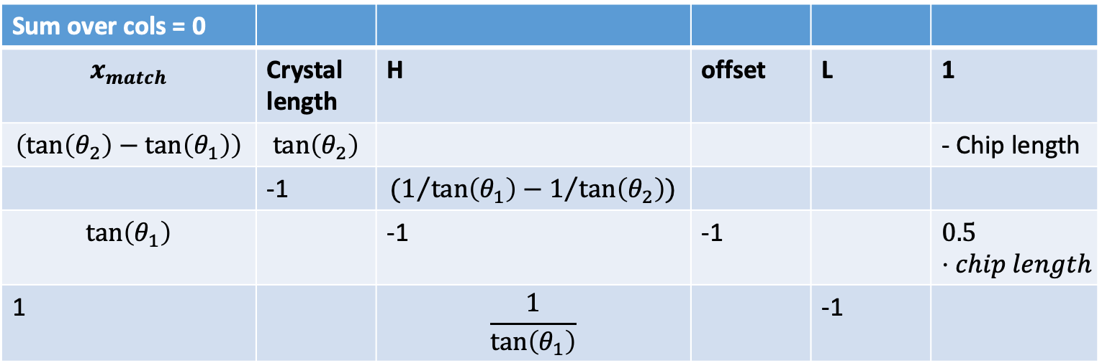
Sum over cols = 0
$$x_{match}$$ | Crystal length | H | offset | L | 1
$$\left(\tan\left(θ_{2}\right)−\tan\left(θ_{1}\right)\right)$$ | $$\tan\left(θ_{2}\right)$$ |  |  |  | - Chip length
 | -1 | $$(1/{\tan\left(θ_{1}\right)}−1/{\tan\left(θ_{2}\right)})$$
$$\tan\left(θ_{1}\right)$$ |  | -1 | -1 |  | $$0.5⋅chip length$$
1 |  | $$\frac{1}{\tan\left(θ_{1}\right)}$$ |  | -1

Slide 16
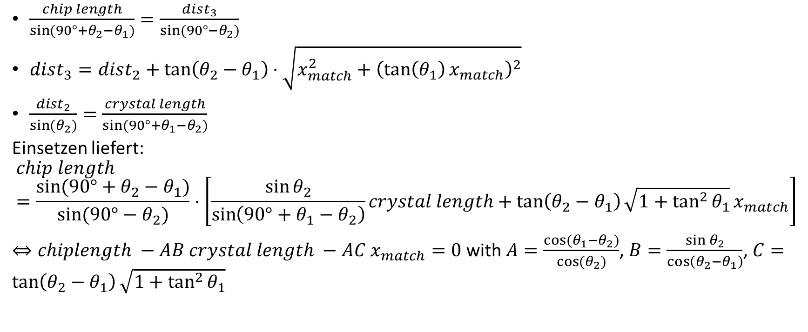
New Equation needed
$\frac{chip length}{\sin{(90°+θ_{2}−θ_{1})}}=\frac{dist_{3}}{\sin{(90°−θ_{2})}}$
$dist_{3}=dist_{2}+\tan\left(θ_{2}−θ_{1}\right)⋅\sqrt{x_{match}^{2}+{\left(\tan\left(θ_{1}\right)x_{match}\right)}^{2}}$
$\frac{dist_{2}}{\sin{(θ_{2})}}=\frac{crystal length}{sin⁡(90°+θ_{1}−θ_{2})}$
Einsetzen liefert:
$$chip length=\frac{sin⁡(90°+θ_{2}−θ_{1})}{\sin{(90°−θ_{2})}}⋅\left[\frac{\sin{θ_{2}}}{\sin\left(90°+θ_{1}−θ_{2}\right)}crystal length+\tan\left(θ_{2}−θ_{1}\right)\sqrt{1+\tan^{2}{θ_{1}}}x_{match}\right]$$ $⇔chiplength −AB crystal length −AC x_{match}=0$ with $A=\frac{cos(θ_{1}−θ_{2})}{\cos{(θ_{2})}}$, $B=\frac{\sin{θ_{2}}}{\cos\left(θ_{2}−θ_{1}\right)}$, $C=\tan\left(θ_{2}−θ_{1}\right)\sqrt{1+\tan^{2}{θ_{1}}}$

Slide 17
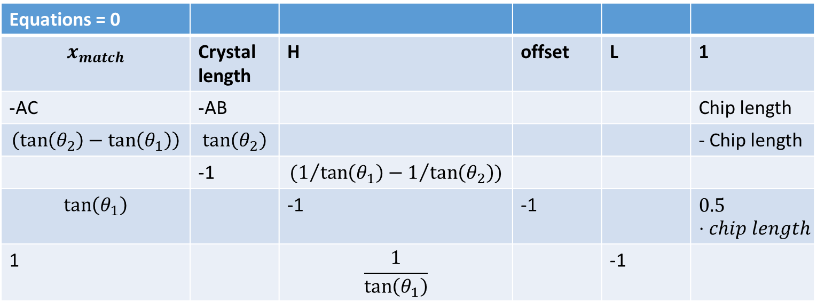
Equations = 0
$$x_{match}$$ | Crystal length | H | offset | L | 1
-AC | -AB |  |  |  | Chip length
$$\left(\tan\left(θ_{2}\right)−\tan\left(θ_{1}\right)\right)$$ | $$\tan\left(θ_{2}\right)$$ |  |  |  | - Chip length
 | -1 | $$(1/{\tan\left(θ_{1}\right)}−1/{\tan\left(θ_{2}\right)})$$
$$\tan\left(θ_{1}\right)$$ |  | -1 | -1 |  | $$0.5⋅chip length$$
1 |  | $$\frac{1}{\tan\left(θ_{1}\right)}$$ |  | -1
Implementing this systerm of equations shows that Equatsion I and II are equal.

Slide 18
The system of equations still has the freedom whether more path is covered before or after the crystal.
We choose offset =0 as the as this is required to image the two beam paths (one through Al and one as referencne) on the camera

Slide 19
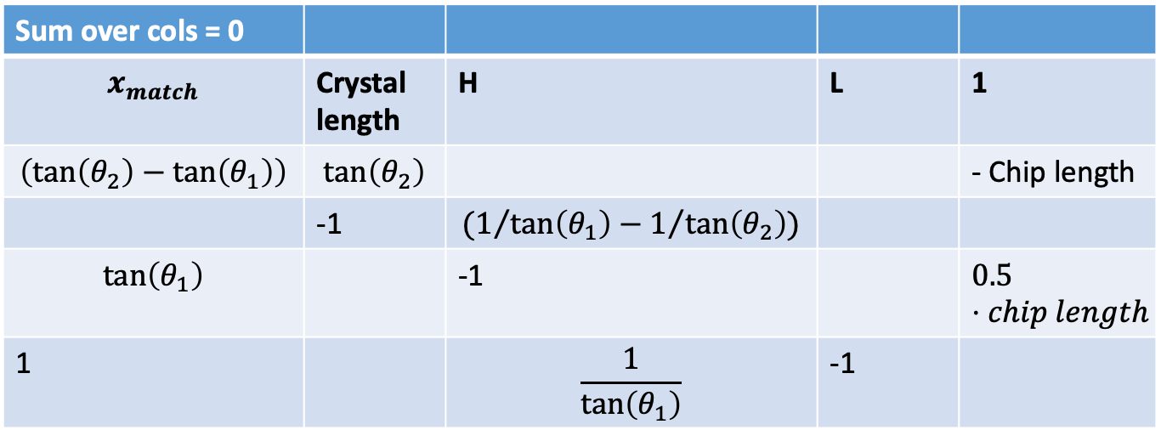
Sum over cols = 0
$$x_{match}$$ | Crystal length | H | L | 1
$$\left(\tan\left(θ_{2}\right)−\tan\left(θ_{1}\right)\right)$$ | $$\tan\left(θ_{2}\right)$$ |  |  | - Chip length
 | -1 | $$(1/{\tan\left(θ_{1}\right)}−1/{\tan\left(θ_{2}\right)})$$
$$\tan\left(θ_{1}\right)$$ |  | -1 |  | $$0.5⋅chip length$$
1 |  | $$\frac{1}{\tan\left(θ_{1}\right)}$$ | -1

Slide 20
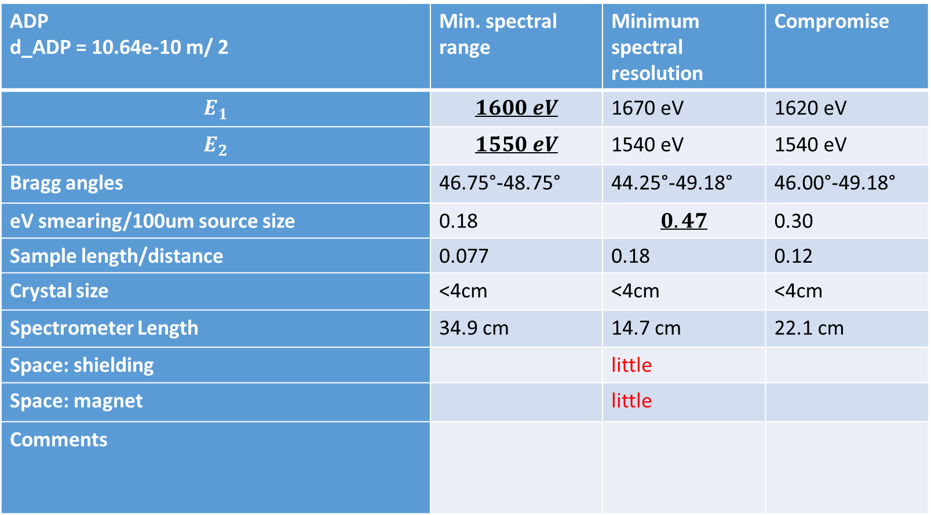
ADP Spectrometer Stats
Crystals from Jena have the following size: l x w x h: 40 mm x 30 mm x 2 mm
ADP d_ADP = 10.64e-10 m/ 2 | Min. spectral range | Minimum spectral resolution | Compromise
$$E_{1}$$ | $$1600 eV$$ | 1670 eV | 1620 eV
$$E_{2}$$ | $$1550 eV$$ | 1540 eV | 1540 eV
Bragg angles | 46.75°-48.75° | 44.25°-49.18° | 46.00°-49.18°
eV smearing/100um source size | 0.18 | $$0.47$$ | 0.30
Sample length/distance | 0.077 | 0.18 | 0.12
Crystal size | <4cm | <4cm | <4cm
Spectrometer Length | 34.9 cm | 14.7 cm | 22.1 cm
Space: shielding |  | little
Space: magnet |  | little
Comments

Slide 21
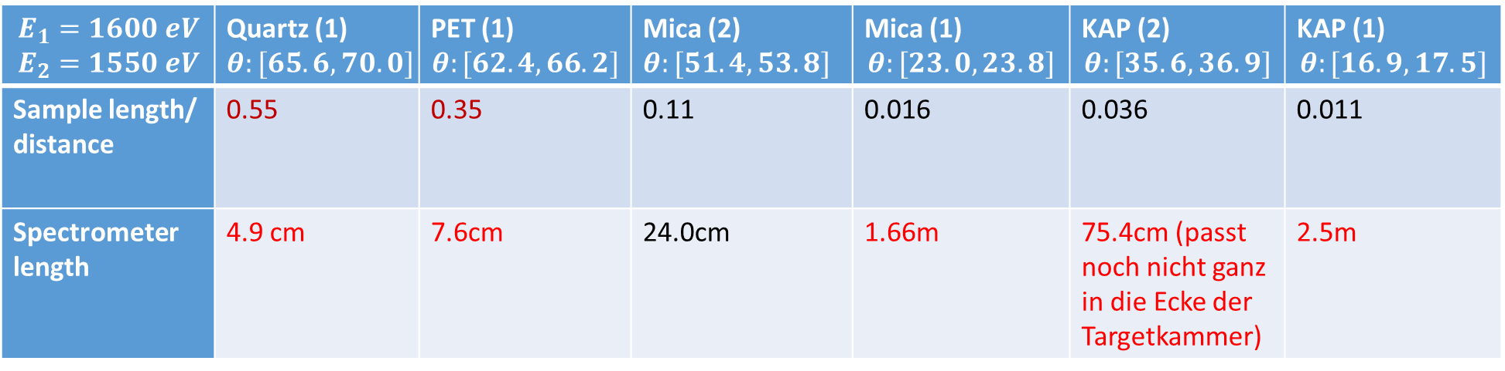
Stats for alternative crystal materials
$$E_{1}=1600 eV$$ $$E_{2}=1550 eV$$ | Quartz (1) $$θ:[65.6, 70.0]$$ | PET (1) $$θ:[62.4, 66.2]$$ | Mica (2) $$θ:[51.4, 53.8]$$ | Mica (1) $$θ:[23.0, 23.8]$$ | KAP (2) $$θ:[35.6, 36.9]$$ | KAP (1) $$θ:[16.9,17.5]$$
Sample length/ distance | 0.55 | 0.35 | 0.11 | 0.016 | 0.036 | 0.011
Spectrometer length | 4.9 cm | 7.6cm | 24.0cm | 1.66m | 75.4cm (passt noch nicht ganz in die Ecke der Targetkammer) | 2.5m
Ecke der Targetkammer meint hier:
Unter 53 deg gehen ca. 70cm Spektrometer Länge in 2 crytals on 1 camera Setup
PHELIX
Ions

Slide 22
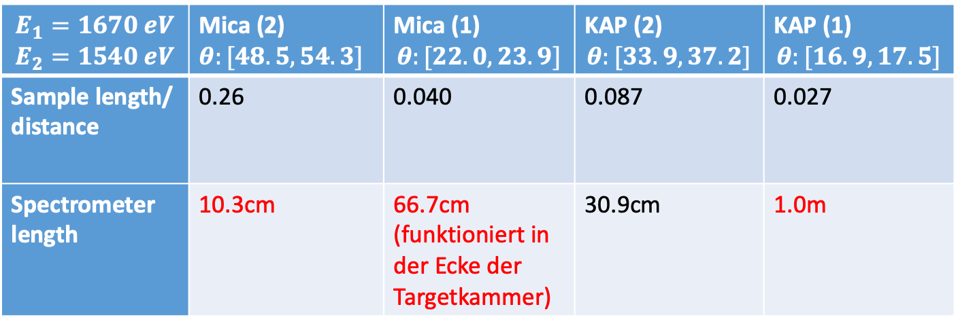
$$E_{1}=1670 eV$$ $$E_{2}=1540 eV$$ | Mica (2) $$θ:[48.5, 54.3]$$ | Mica (1) $$θ:[22.0, 23.9]$$ | KAP (2) $$θ:[33.9, 37.2]$$ | KAP (1) $$θ:[16.9,17.5]$$
Sample length/ distance | 0.26 | 0.040 | 0.087 | 0.027
Spectrometer length | 10.3cm | 66.7cm (funktioniert in der Ecke der Targetkammer) | 30.9cm | 1.0m
KAP 1st order at max. distance of around 0.7 m -> 180eV spectral range
-> 2/3eV resolution
-> Ausdehnung der X-rays auf sample in 3mm Distanz ca. 100um. Oder nur kleinere spectral range tatsächlich nutzen?

Slide 23
Ideas/Questions:
Is ADP spectrometer as proposed above too bulky?
Two separate single-path spectrometers instead of bulky „ADP absoprtion spectrometer“ (would mean 4 spectrometers in total)

Slide 24
Very small sample_len/dist would enable to rotate spectrometer…
One has to ensure that heating homogenous over probed area
This would be in particular possible for small Bragg angles like for KAP (or mica) in first order
But it is hard to fit in the required spectrometer size (for smaller sizes, one has to sacrifice resolution as a larger spectral range is imaged onto detector

Slide 25
Rotated 2C Spectrometer
Sideview
KAP?
View on Camera Chip
Backlighter
Camera Chip
Zentraler Block für Ionenabschirmung. Wird nicht in unserem Experiment da sein. Deshalb noch eine Abschirmung an dieser Stelle einbauen.
E (source spec)
E (trans spec)
27.6mm
PHELIX
6.9mm
Sample
KAP?

Slide 26
Rotated 2C Spectrometer
Topview
Sample
KAP?
(crystals above each other in this view)
Backlighter
PHELIX
Camera Chip
Ions
!!! The smaller the Bragg angles, the more critical becomes this rotation as it reduces the projected angle in sideview !!!

Slide 27
Agreements on 11/28/22
Two crystal ADP spectrometer (no KAP)
mica FSSR spectrometer
overview KAP spectrometer (could look from above -> space is sufficient)

Slide 28
Still open questions
Can FSSR spectrometer give the overview spectra? Does it fit simultaneously with other absorption spectrometer (would make overview spectrometer useless?)

Slide 29
Empfindlichkeit der Geo gegenüber Unsicherheiten in backlighter und sample position untersuchen….
Gedreht aus Ebene (wie für KAP-Kandidaten) empfindlich gegenüber Laser Fluktuationen (Variierung der geprobten Region senkrecht zu Ionenstrahl). Aber ist eigentlich analog für Spektrometer in Ebene. Wenn Quelle um 100um springt, varriiert geprobte Region auch um 100um - epsilon

Slide 30
Überlegungen zu Anordnung FSSR…
Rotating FSSR accordingly to target alignment for other spectrometer? Or two target types? Imaging quality?
Going out of plane necessary to keep space for laser beam?

